Slide 1
The replication crisis in social psychology
A personal, first person account
Michael Inzlicht
University of Toronto
Associate Editor, Psychological Science

Slide 2
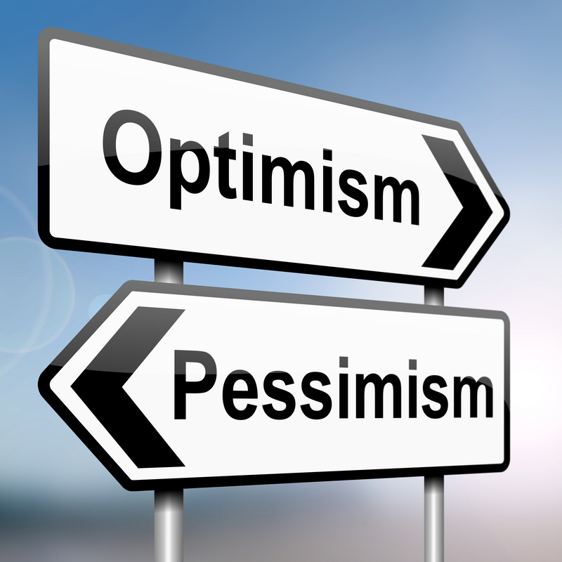
Not your typical talk
This is a personal story, my story
people disagree with my view
Some people call me names!
I have a pessimistic view of field
But there are reasons to be optimistic
Note about me: I am a fast talker
Ask me questions to slow me down!

Slide 3

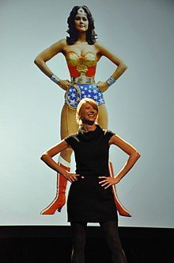
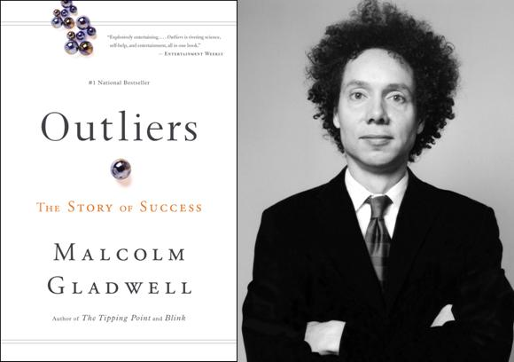

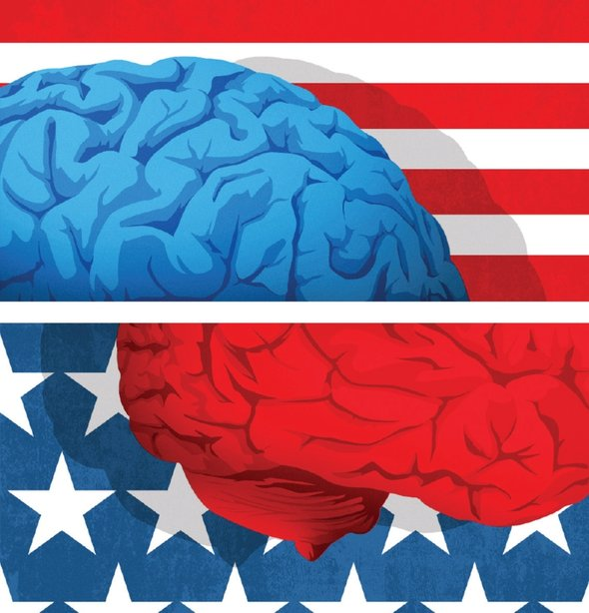

Why all the pessimism? This is a golden age for psychology

Slide 4

A personal Account
Grad school: Brown Univ (USA) 1997-2001
Post-Doc: NYU, 2001-2004
Faculty: Wilfrid Laurier University, 2004-2005
U of Toronto, 2005-2019
2 major chapters in my career (so far)
Stereotype threat (& stigma)
Self-control, including ego depletion

Slide 5
How I got my post-doc Stereotype threat (Inzlicht & Ben-zeev, 2000)
N=72

Slide 6
How I got my job stereotype threat & depletion (Inzlicht, mckay, & aronson, 2006
N=61

Slide 7
How I got tenure ego depletion (inzlicht & Gutsell, 2007)
N=33

Slide 8

I was doing good research, right?
I was rewarded for my work
Papers
Grants
Promotions
Awards
My work was revealing deep “truths”
Sure, I made the occasional error (we all make mistakes), but my work was solid
But, then my conception of the world changed, as if a veil had been lifted

Slide 9
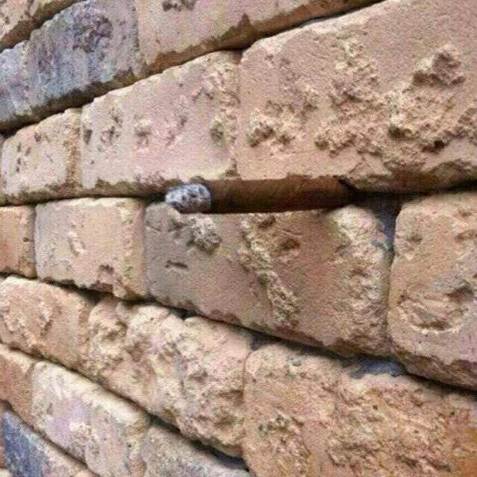
Once you see it, you can’t unsee it

Slide 10
Abusing Experimenter degrees of freedom “normal” research practices make impossible possible
Under-powered designs
N=20 per cell was something we aspired to
Optional stopping
Dropping conditions
Dropping dependent variables
Selective reporting of DVs
Flexibility in operationalizing DVs
Dropping participants
Use of exploratory moderators
Use of exploratory covariates
F(1, 17) = 4.92, p = .040

Slide 11
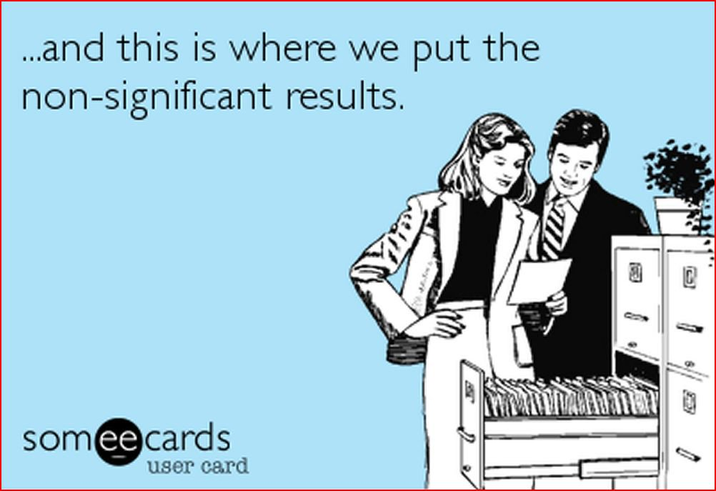
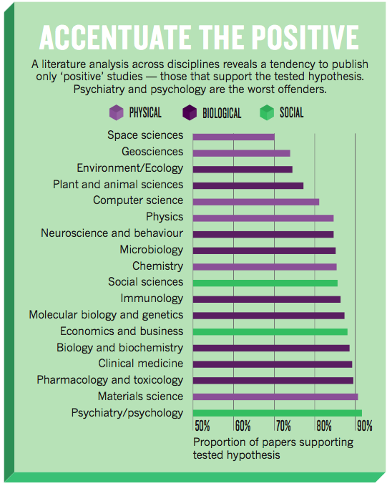
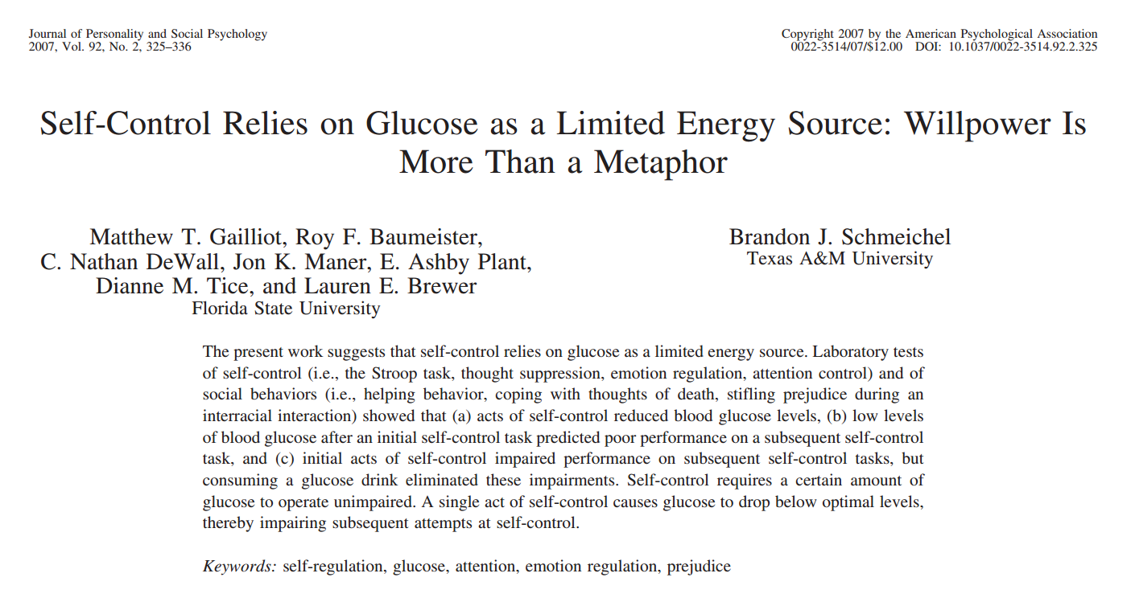
Publication bias published literature ≠ complete literature
Notes:
The term "file drawer problem" was coined by the psychologist Robert Rosenthal in 1979. Positive-results bias, a type of publication bias, occurs when authors are more likely to submit, or editors accept, positive compared to negative or inconclusive results.
If we found out that that 9 study JPSP paper was actually the results of 40 actual studies being run, it changes how we evaluate the strength of evidence. We still might believe the effect, but our confidence is greatly diminished.
The problem with this is that now the size and veracity of an entire literature comes under deep questioning; are all those results great evidence that your phenomenon of interest is real and robust or is it merely the product of hundreds of motivated researchers around the world trying, repeatedly to find an effect and occasionally finding them?

Slide 12

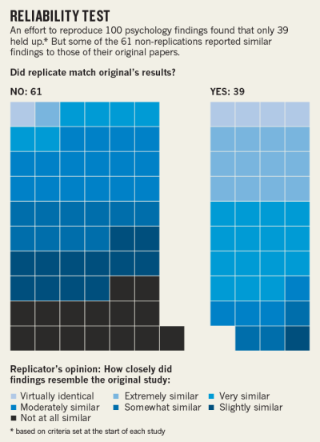
This is all theoretical! Published record is robust, right?
Replication %
Overall: 39%
Cognitive: 55%
Social: 25%

Slide 13
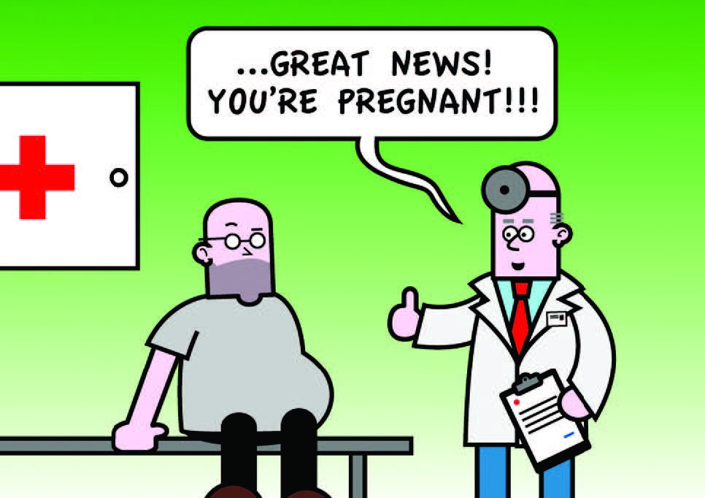
Not only in theory False discovery rate in psychology
Reproducibility Project 61%
Many Labs 1 23%
Many Labs 2 50%
Many Labs 3 70%
Total False Discovery Rate ~51%
NOTE: Not representative samples

Slide 14
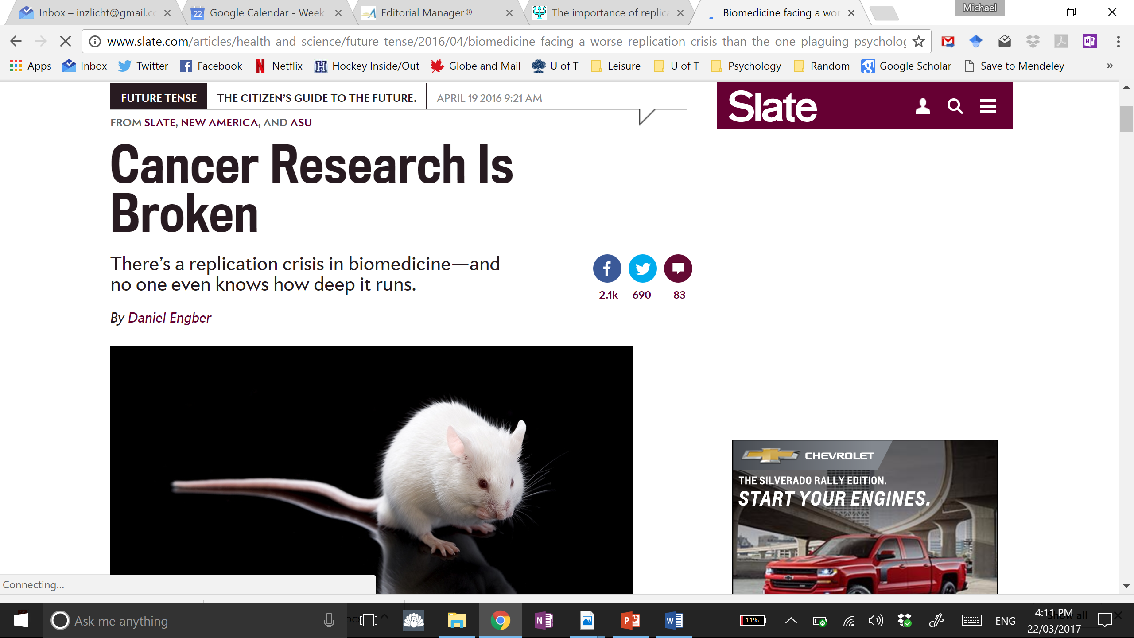
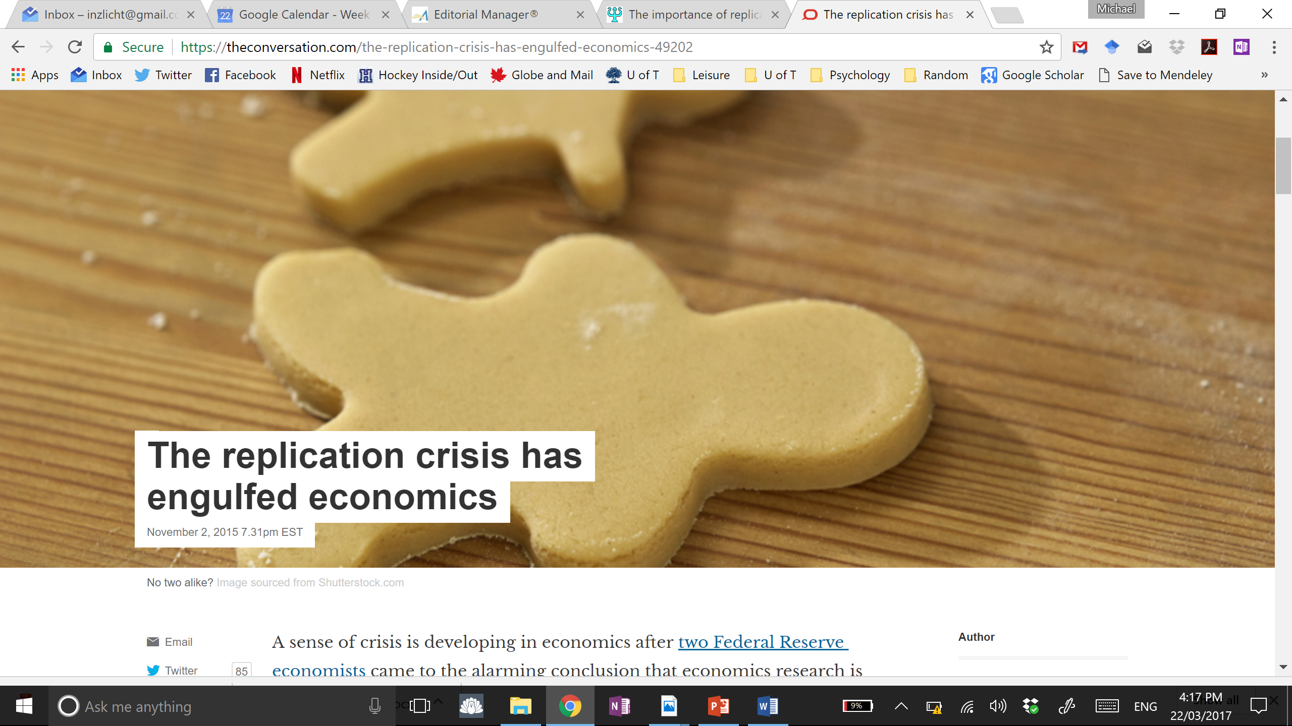
A quick aside this not only psychology’s problem

Slide 15
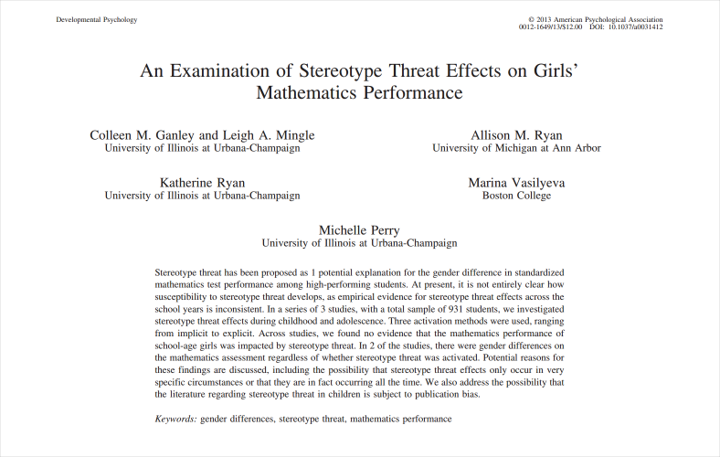
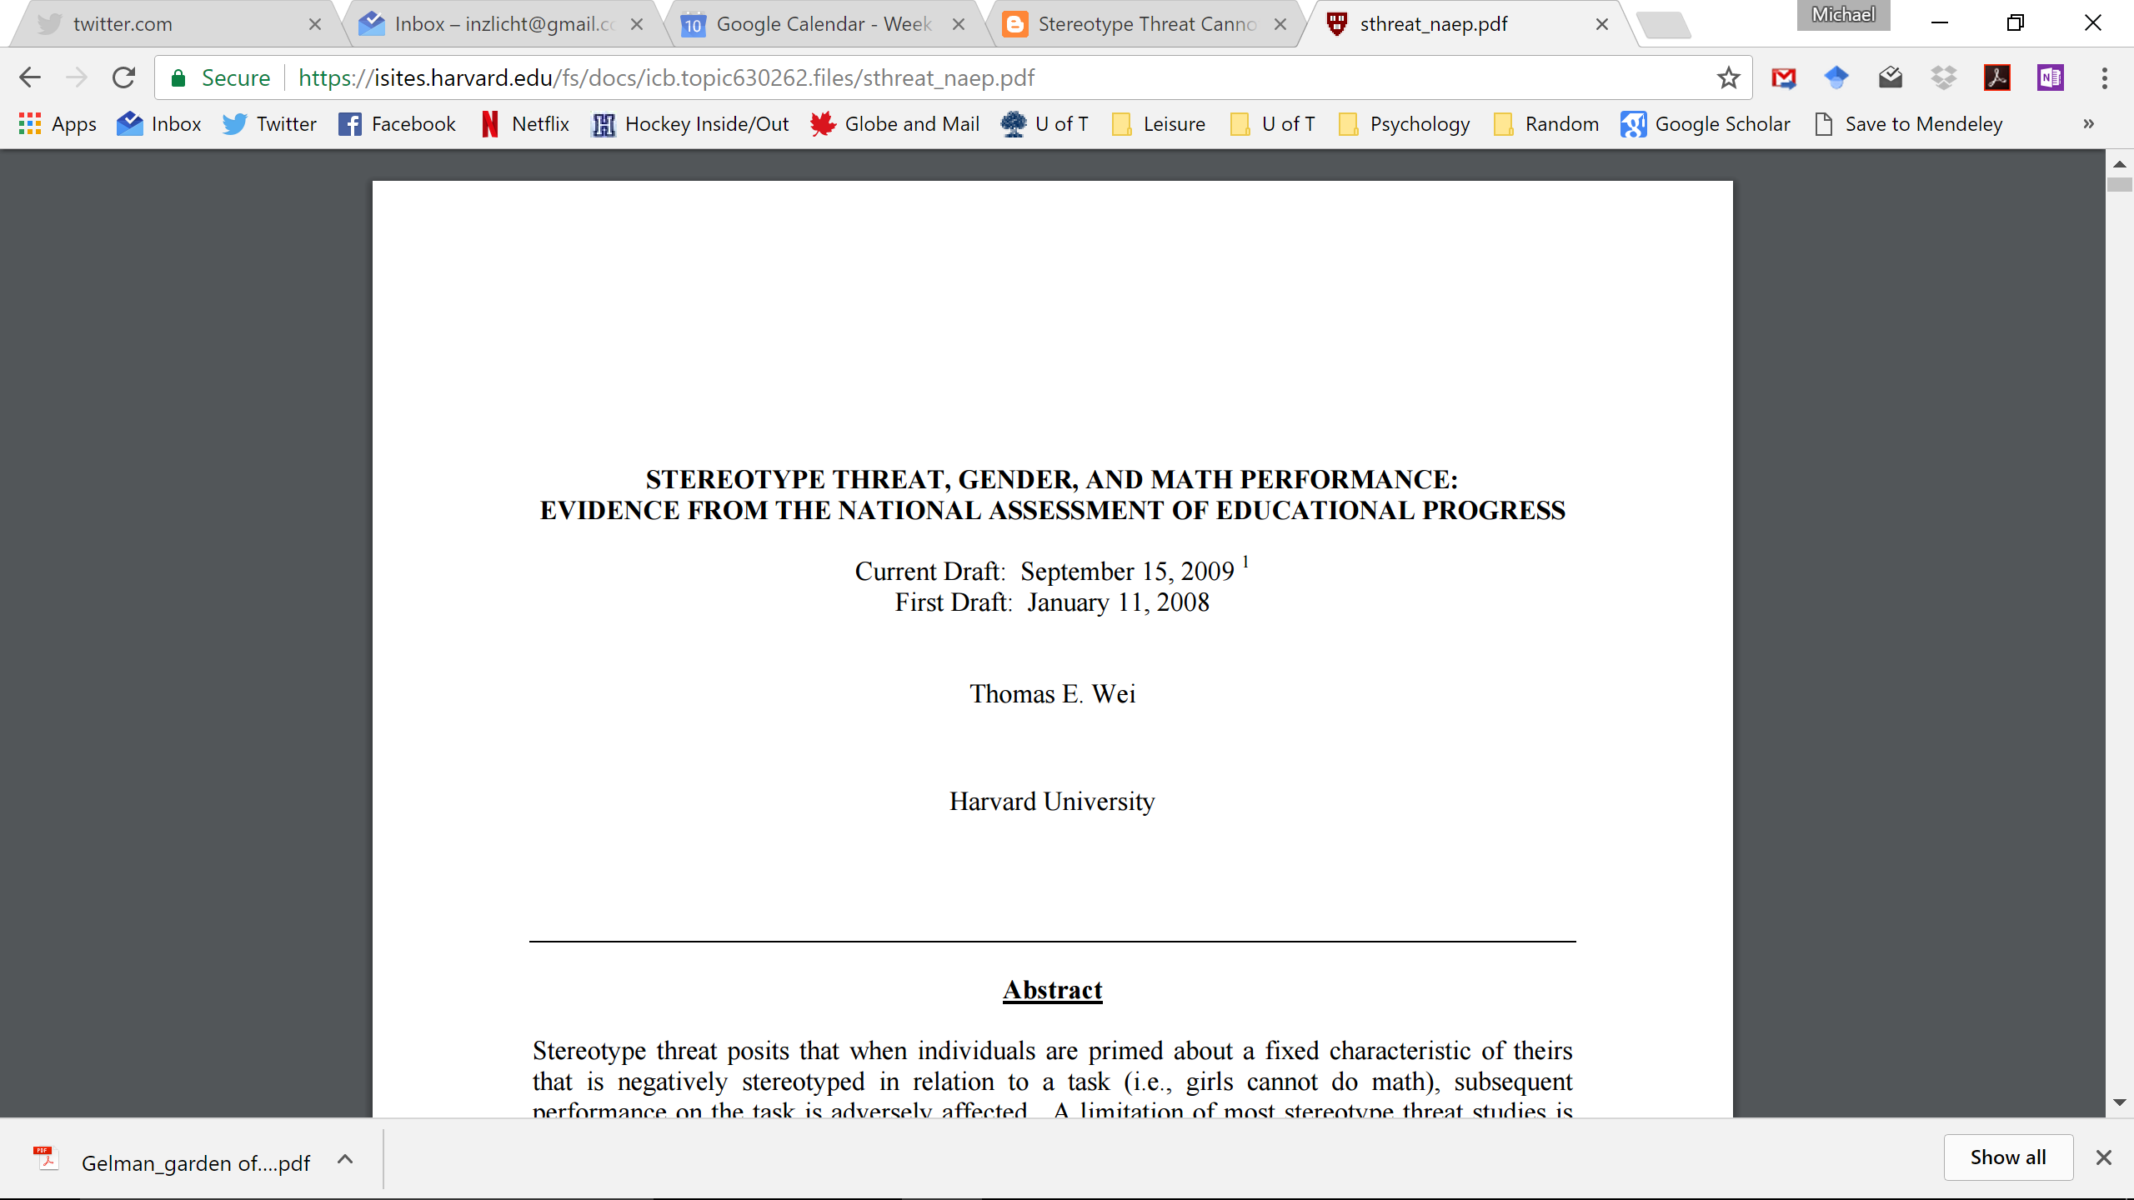
This is about what other people study what about what I study? Stereotype threat
1978 – 1999; N >100,000

Slide 16
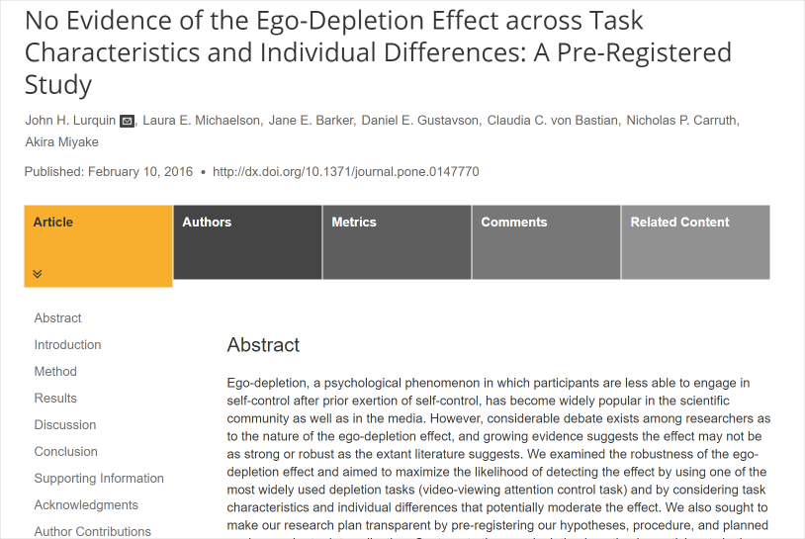
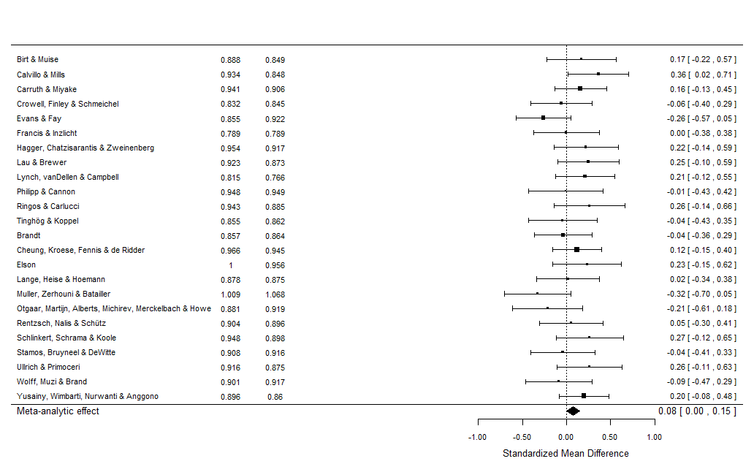
This is about what other people study what about what I study? Ego depletion
24 Labs, >2,400 participants
Method approved by Baumeister
23/24 labs predicted replicable efect

Slide 17
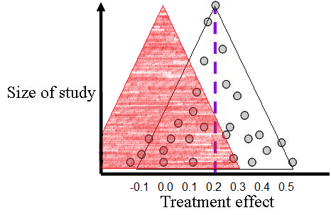
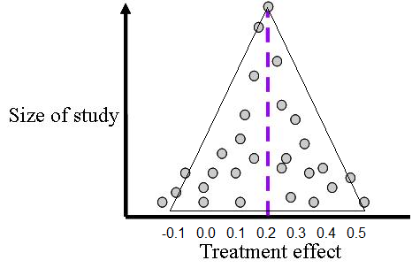
Who cares about a few non-replications?
Replications only test robustness of one study
Hundreds of studies support stereotype threat & ego depletion
Meta-analysis to the rescue!
Publication bias makes meta-analyses (practically) meaningless
Funnel plots can spot problems
Notes:
Funnel plots examine the relationship between effect size and sample size. In an unbiased sample, a complete sample, there is no relationship between effect size and sample size.
The relationship between gender and height, for example, should be the same whether I measure 4 men and women, 40 men and women, or 4,000 men and women. Yes, my estimates will be less precise the smaller my samples, but if I repeatedly sample from the population, my overall estimates will converge on the real effect size.
Now, when I do find an association between sample size and effect size, this is a clue. It means that I am missing part of the literature.

Slide 18
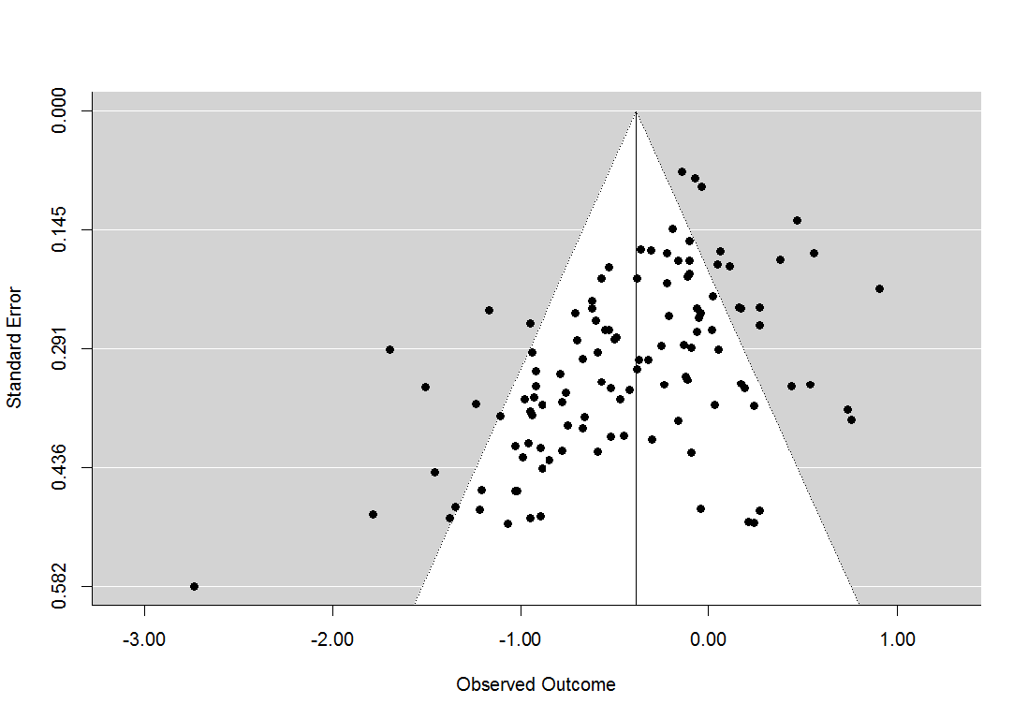
Funnel plot—Stereotype Threat
Trim & Fill
[-.30, -.08]
PEESE
[-.10, 0.11]
Top10
[-.14, 0.01]
FILE DRAWER

Slide 19
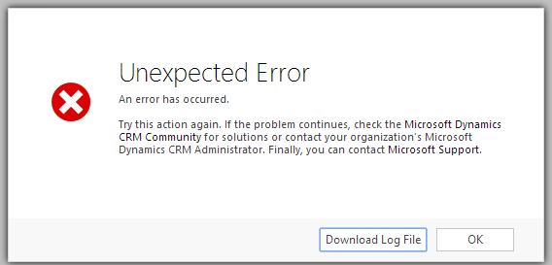
We have made big & systematic errors
Is psychology (and other social sciences) built on a solid foundation?
I’m no longer sure what I can trust
I’m no longer sure I can trust my own past work

Slide 20
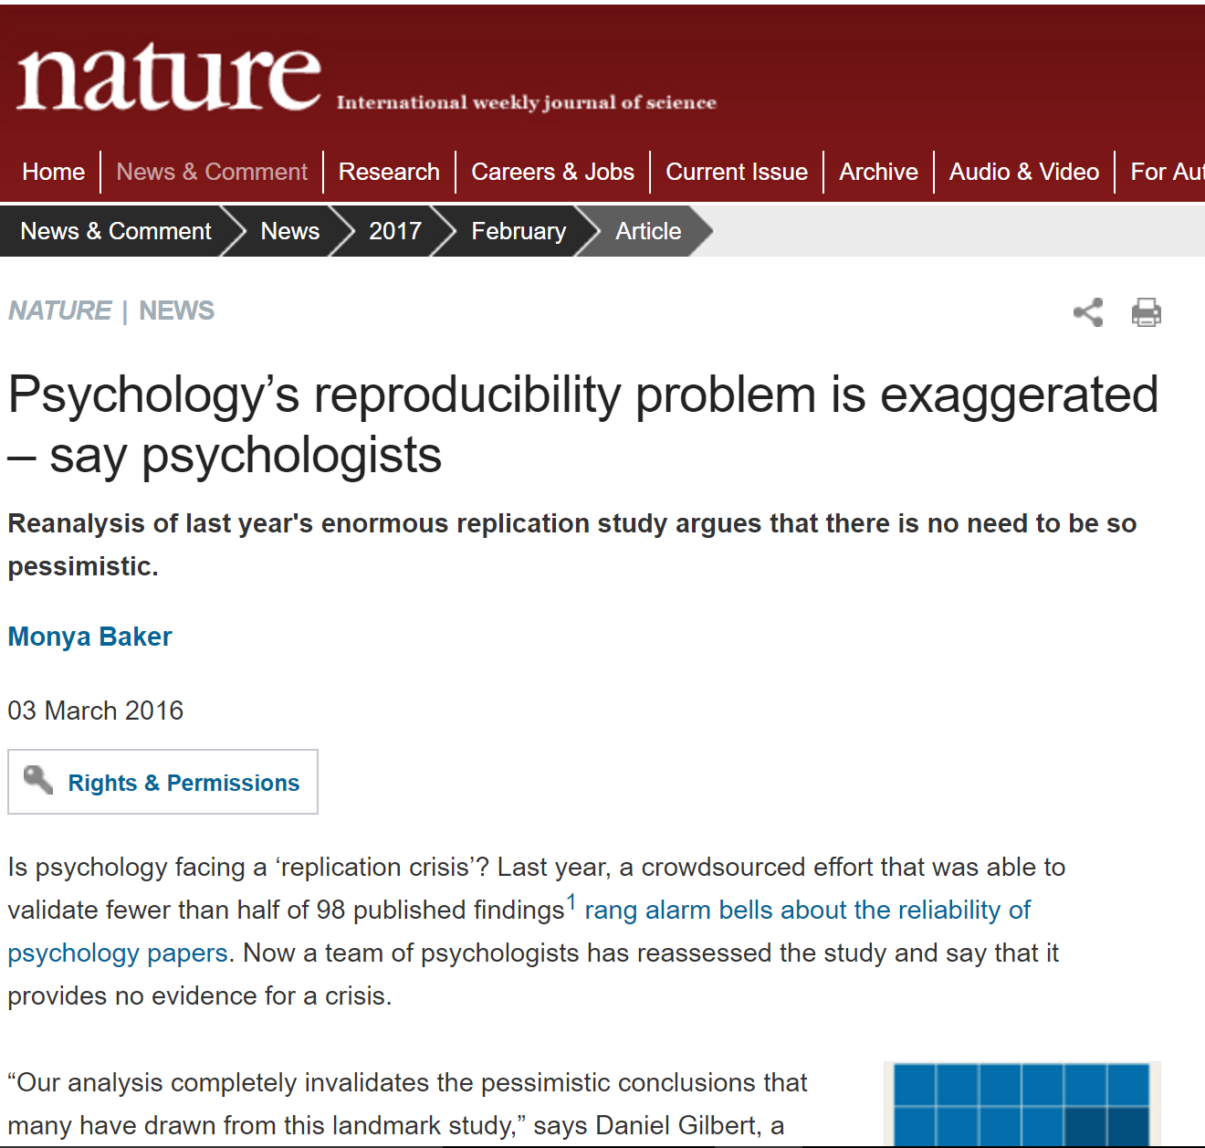
Everything is fine, no problems here
Scientists interested in improving psychology are not to be trusted
They are:
Shameless Little Bullies
Nazis
Witch hunters
Data Parasites
Methodological Terrorists
Human Scum
Name calling is product of motivated reasoning, threats to status

Slide 21
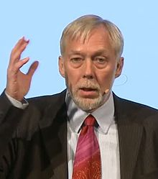
I’m no longer sure what is real ANYMORE
“I don't know what I would believe in social psychology if it were true that there is no ego depletion effect.”
Roy Baumeister, June 2016

Slide 22
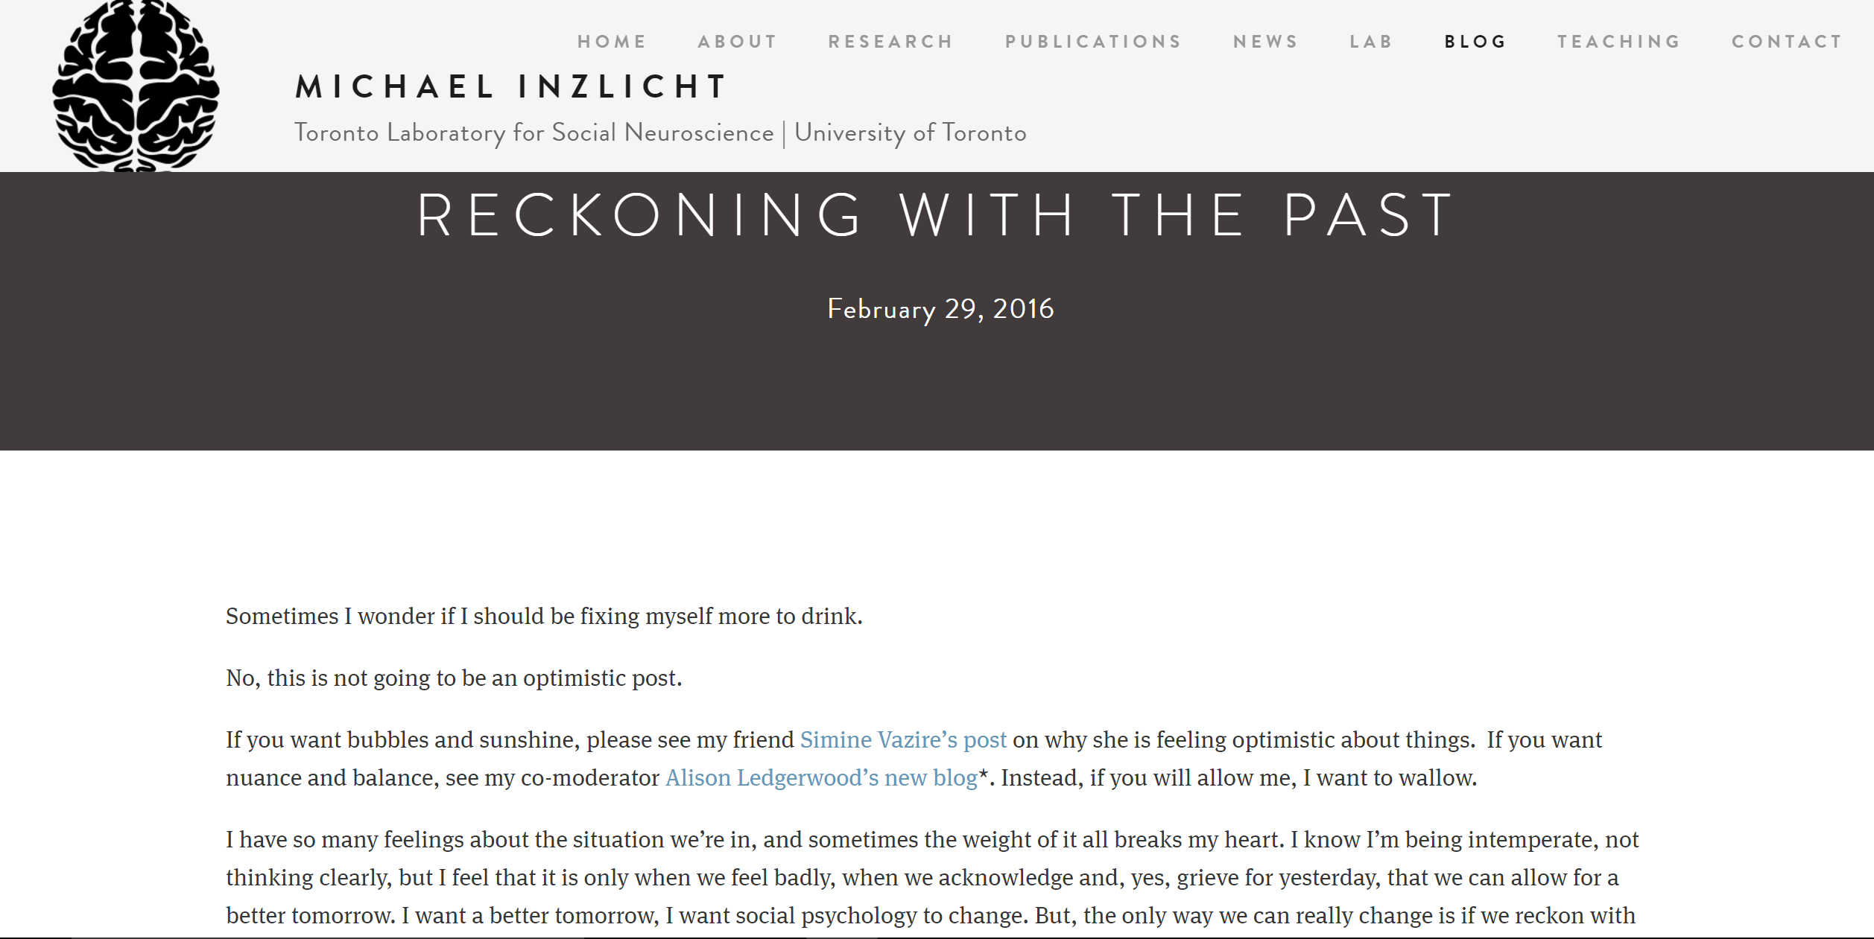
Have I been chasing puffs of smoke?

Slide 23
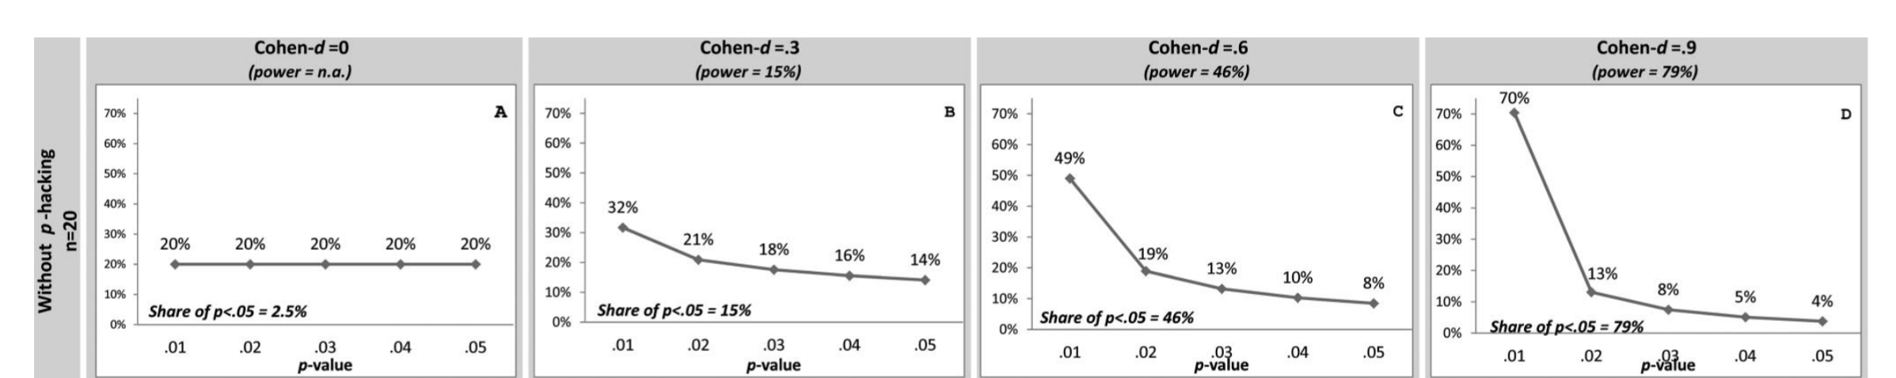
How can we check reliability of field? P-curve to the rescue!

Slide 24
P-curving is easy I use it as an editor & reviewer
P-curve app
F(1, 52)=5.34
F(1,50)=4.18
F(1, 63)=4.78
Notes:
This paper has been cited over 2,000 times
P=.025
P=.046
P=.033

Slide 25
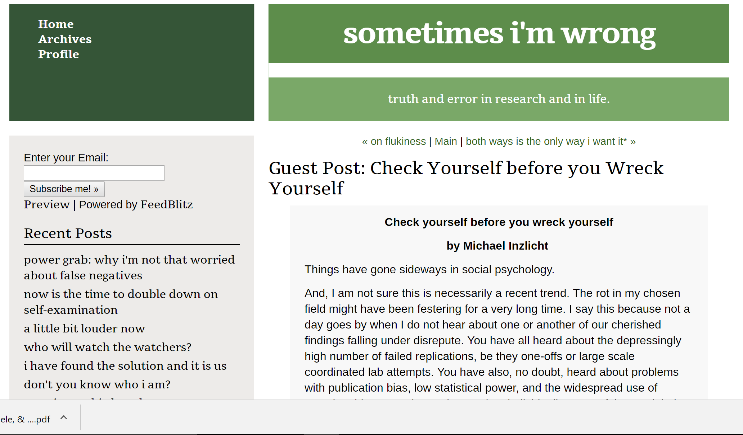
areas I work in are problematic but my work is not problematic, right? Right?
P-curve app
F(1, 67)=3.8
F(1, 67)=3.12
F(9, 1764)=5.39
F(1, 49)=6.97
F(3, 125)=2.98
F(2, 40)=5.34
F(2, 65)=5.28
F(1, 35)=5.75
F(1, 35)=8.36
F(1, 31)=6.06
t(36)=2.66
F(1, 36)=4.97
F(1, 54)=3.28
t(21)=2.34
t(34)=2.52
F(1, 31)=3.89
r(40)=.38
t(64)=1.87

Slide 26
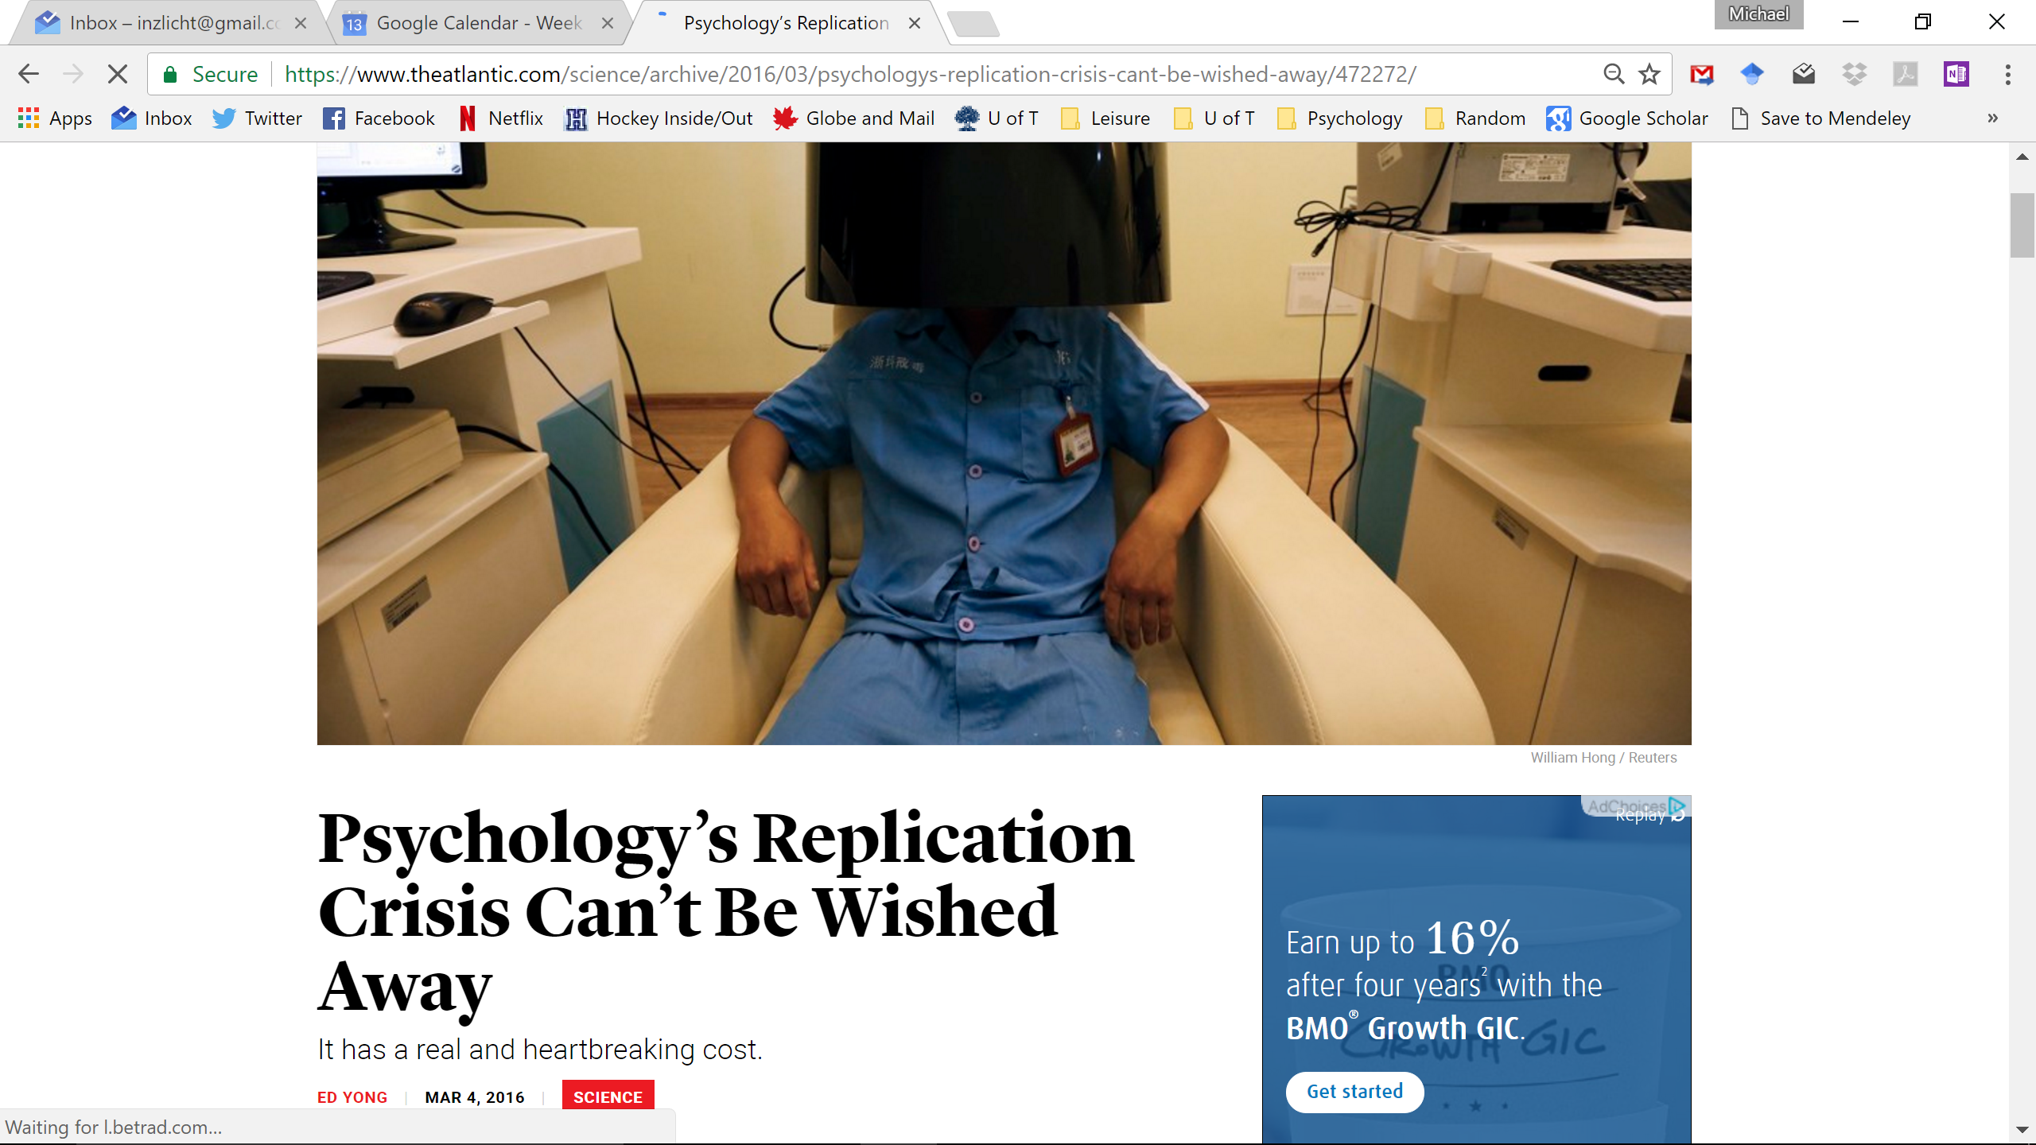

Temptation to deny & minimize problems
Notes:
It would be so easy to deny ;
Instead we could pay attention and listen to our critics

Slide 27
I’ve listened to critics & tried to improve please please please tell me I’ve gotten better!
P-curve app
chi2(1)=6.71
chi2(1)=0.47
chi2(1)=5.42
Z=2.75
Z=1.6545
Z=3.3
Z=4.05
r(54)=.3
t(72)=2.63
t(66)=0.08
Z=2.054
Z=2.575
F(1, 38)=107.89
F(1, 40)=4.213
F(1, 40)=0.517
F(1, 54)=7
F(1, 302.27)=7.62
t(48.259)=12.67
t(47.861)=3.819
Notes:
I’ve been paying close attention to the debates in my field

Slide 28

How to improve? Start considering power
Power
P of finding effect, when effect is real
We have mostly ignored power
Increase sample sizes
N=200 rule of thumb?
Run more high-powered designs
Within-subject designs
Avoid one-shot dependent variables

Slide 29
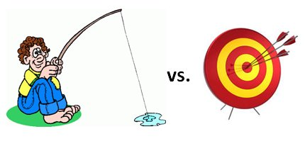
How to improve? Conduct confirmatory studies
Understand the difference between confirmatory & exploratory studies
Explore all you want, but then confirm
Consider pre-registering your studies
Pre-registration signals that your studies are confirmatory
It keeps you honest with yourself
Consider Registered Reports

Slide 30
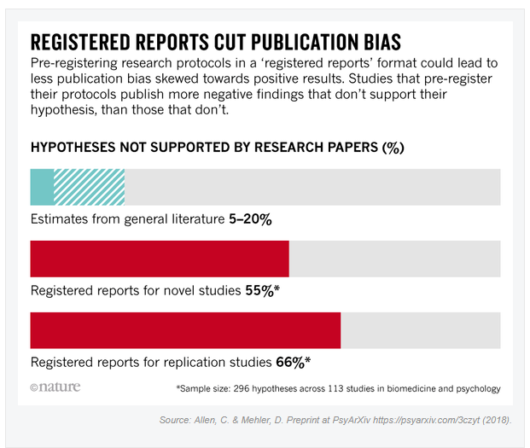
Future of science: registered reports
Propose studies, which get accepted before data collected
Papers evaluated on quality of ideas & methods
Does not reward specific results, p-hacking
Null results get published

Slide 31
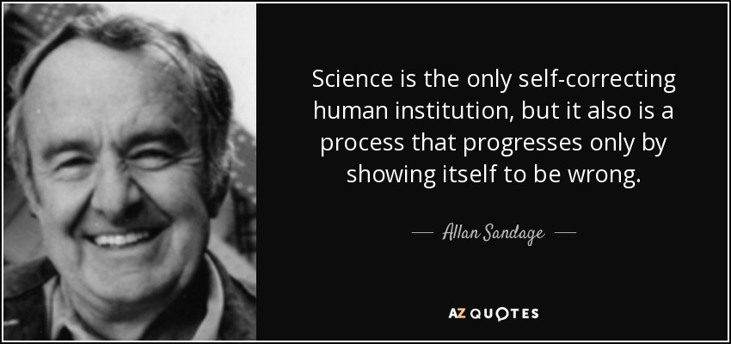
We’re getting better!
Science is self-correcting
But it is scientists correcting other scientists
Reckoning with the past is painful
We endure pain out of love of field
We are showing signs of improvement
More powerful studies
More awareness of problems
More replicable results

Slide 32
Thank you!

